Slide 1
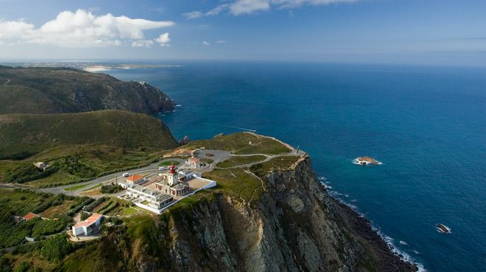
PORTUGAL and little bit of Spain
Mia Rebrović

Slide 2
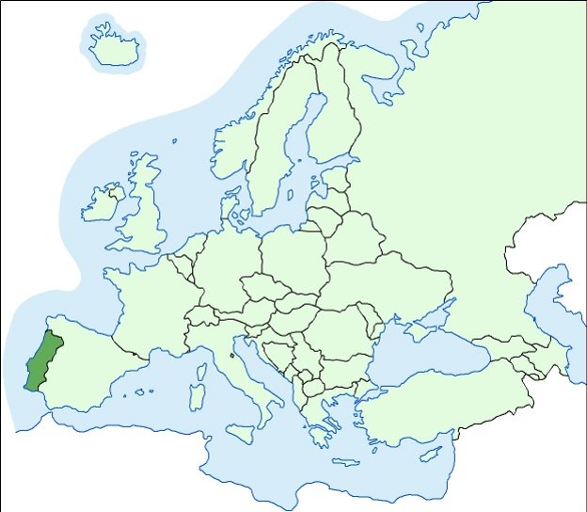
2h 50min
1h 50min

Slide 3
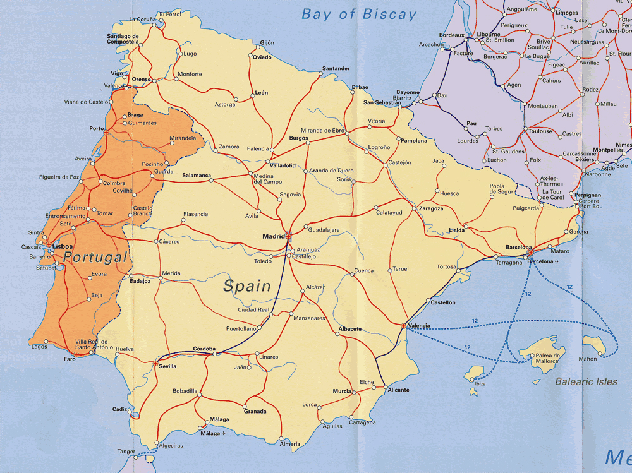

Slide 4
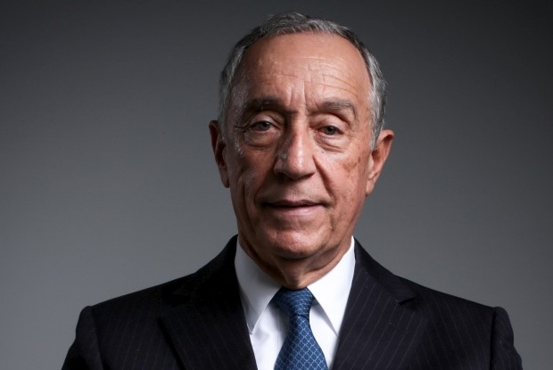
About Portugal...
Area: 92,212 km²
Population: 10,562,178 (2011 census)
Capital: Lisbon
Official languages Portuguese
President: Marcelo Rebelo de Sousa

Slide 5
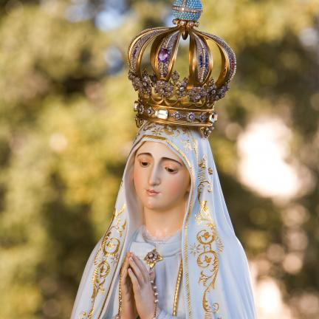
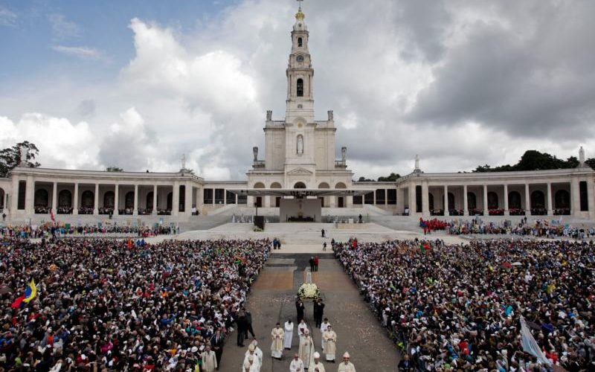
1.FÁTIMA
Fatima is small town in Portugal famous for Lady of Fatima
today it is famous sanctuary
Area: 71,83 km²
Population: 11 596

Slide 6
The story...
Lady of Ftima showed up on May 13th 1917 to the Lúcia, Francisco and Jacinta. She told them to go to that place every 13th of the month. They have seen her six times from May to October.
Although they have all seen her Lúcia and Jancita have heard her and only Lúcia have the honor to spoke to her. She told them meny secrets, showed them hell, predict the end of WW1 and protect Portugal from WW2.
They wanted to thank her for that so portuguese women donate their wedding rings and other piece of jullery to make a crown for the Lady of Fatima. The pope John Paul ll. Was very conected with her so he donate the bullet he was shoot with.
Francisco and Jacinta died at the age of 10 but Lúcia lived very long because Lady chose her to tell others everything she told her.

Slide 7
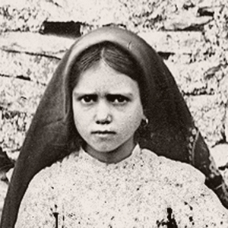
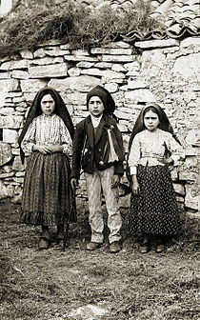
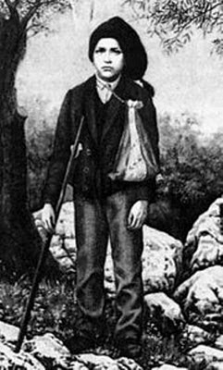
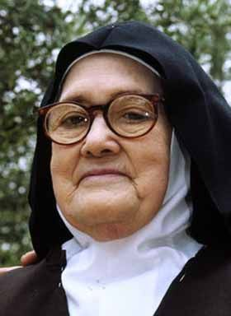
Kids...
Jacinta
Born March 11, 1910
Died February 20, 1920
Francisco
Born June 11, 1908
Died April 4, 1919
Lúcia
Born March 28, 1907
Died February 13, 2005

Slide 8
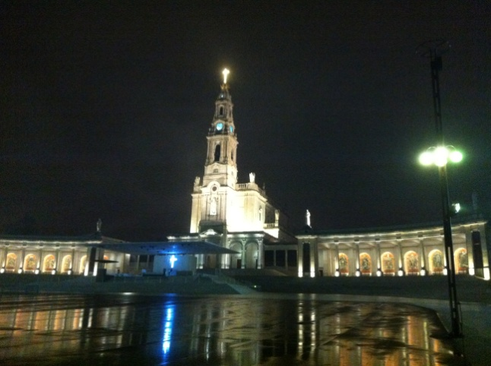
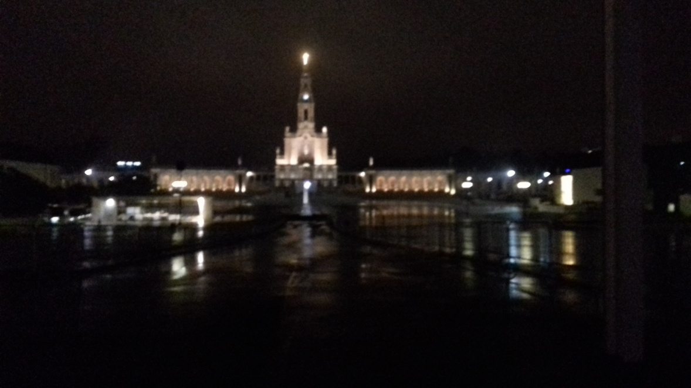
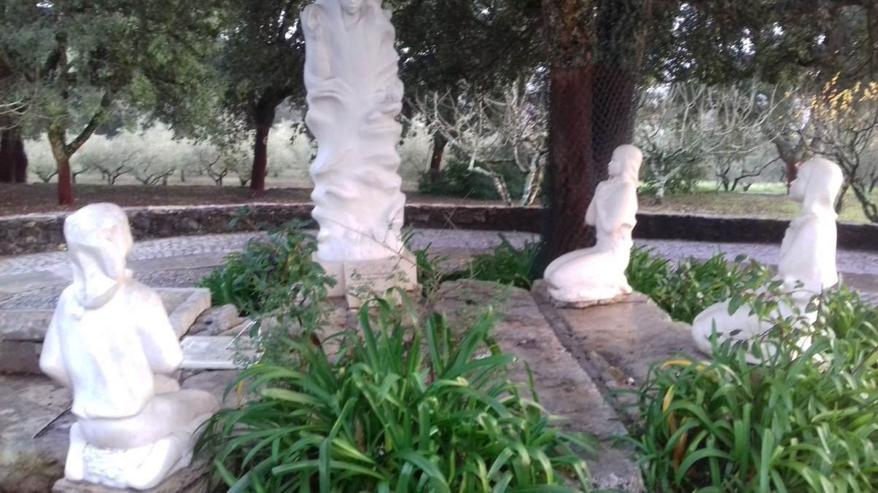
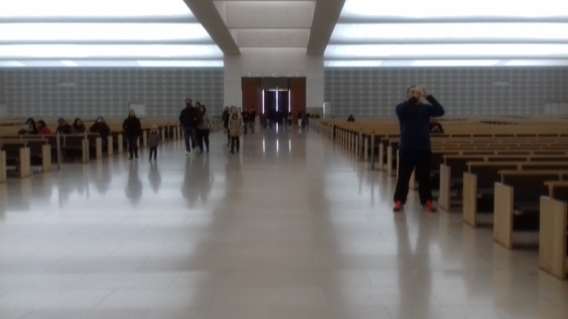

Slide 9
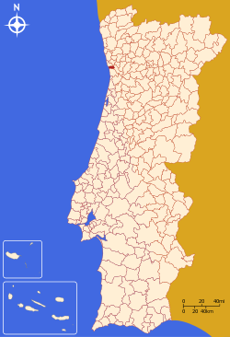
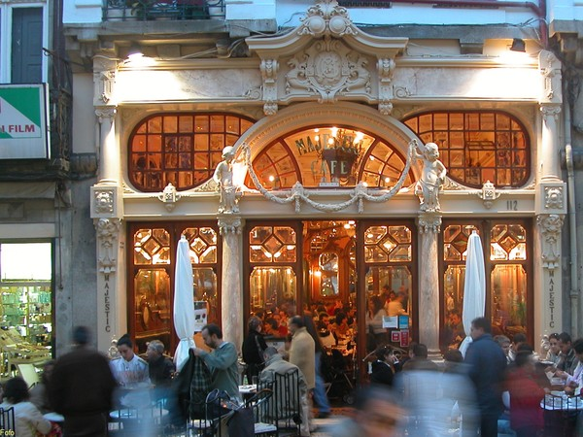
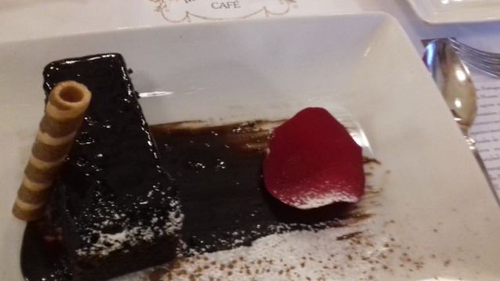
2.PORTO
the second largest cityin Portuga
Area 41.42 km²
Population 287,591

Slide 10
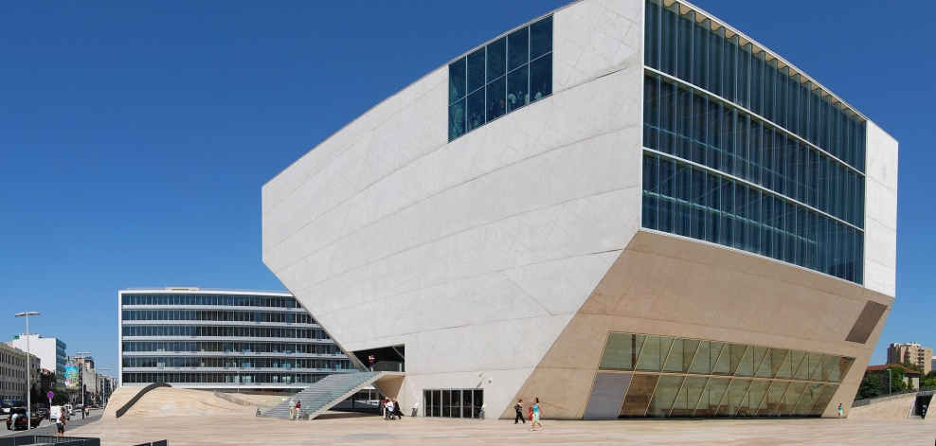
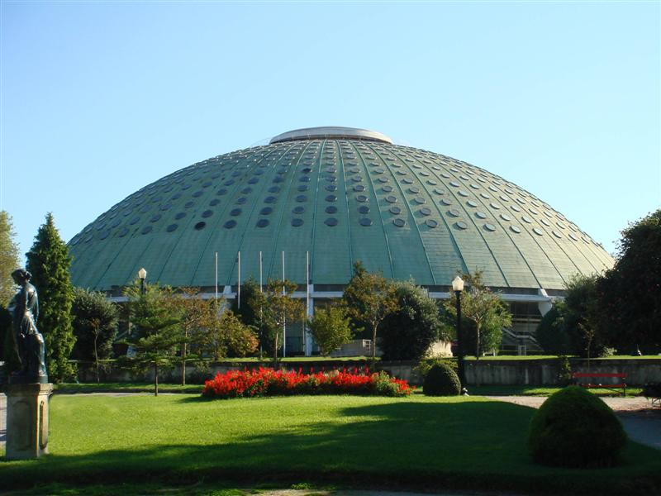
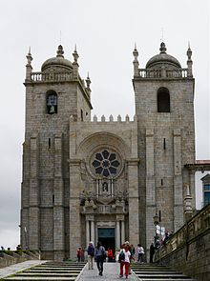
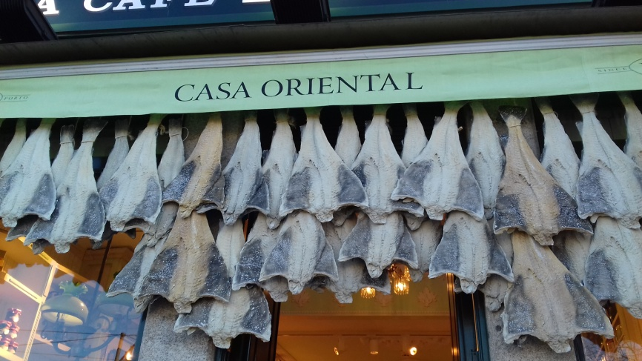
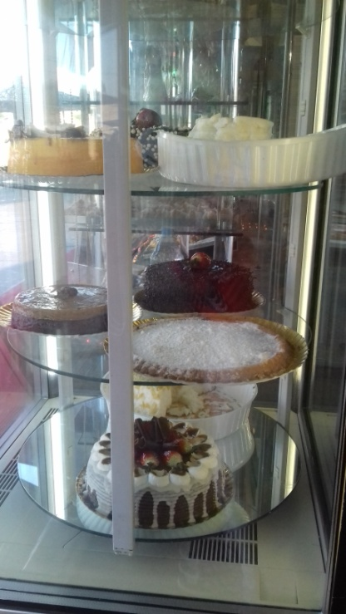

Slide 11
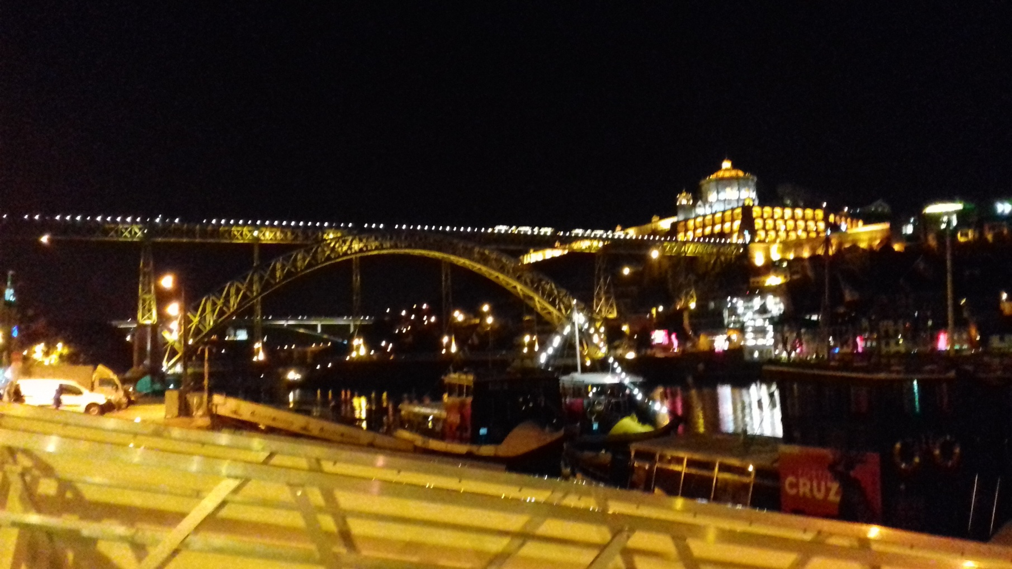

Slide 12
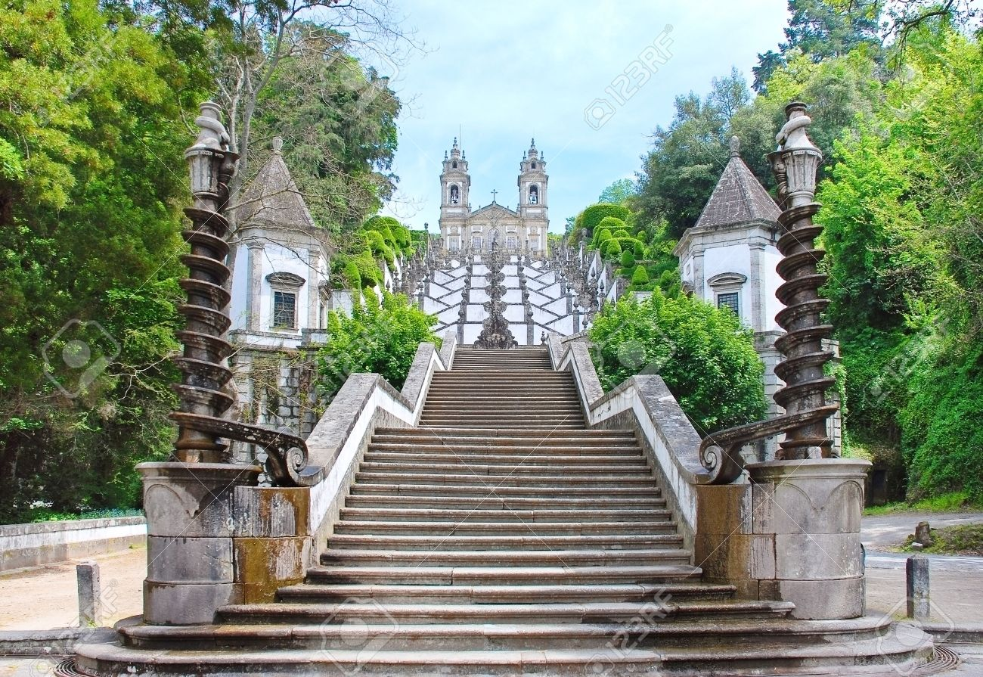
Bom Jesus do Monte

Slide 13
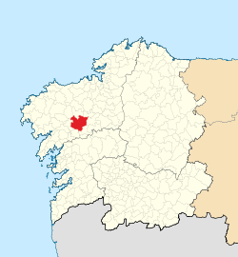
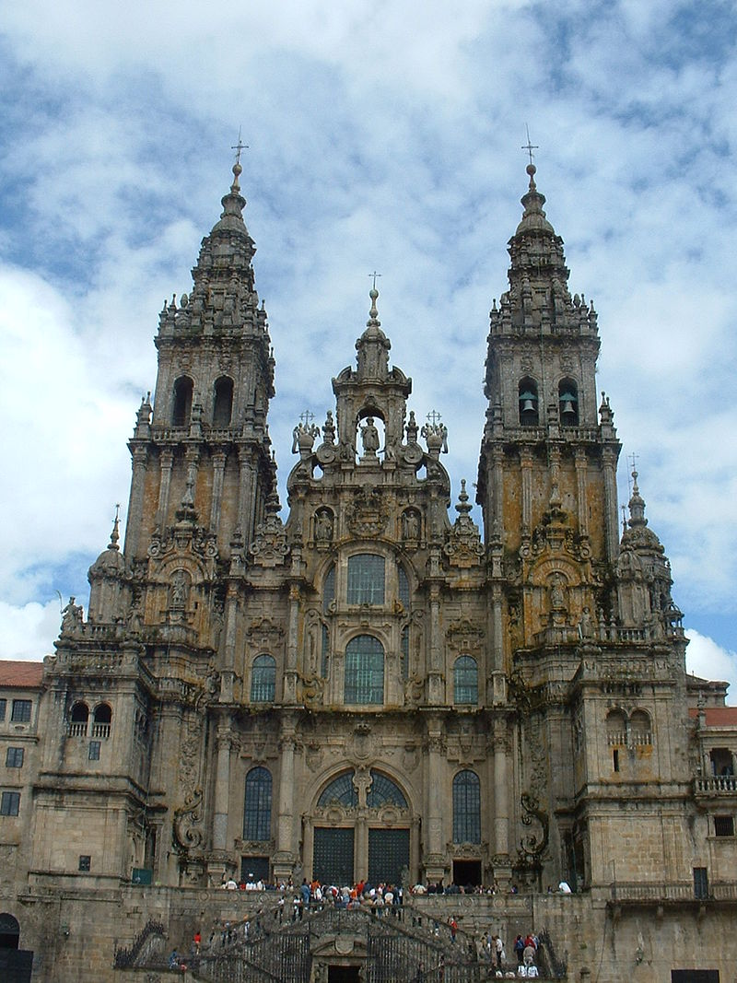
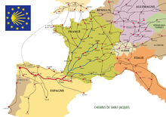
3. Santiago de Compostela
the capital of the autonomous community of Galicia
Area 220 km²
Population 95,671

Slide 14
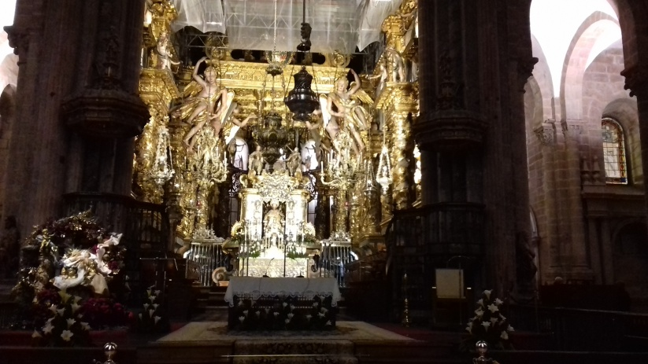
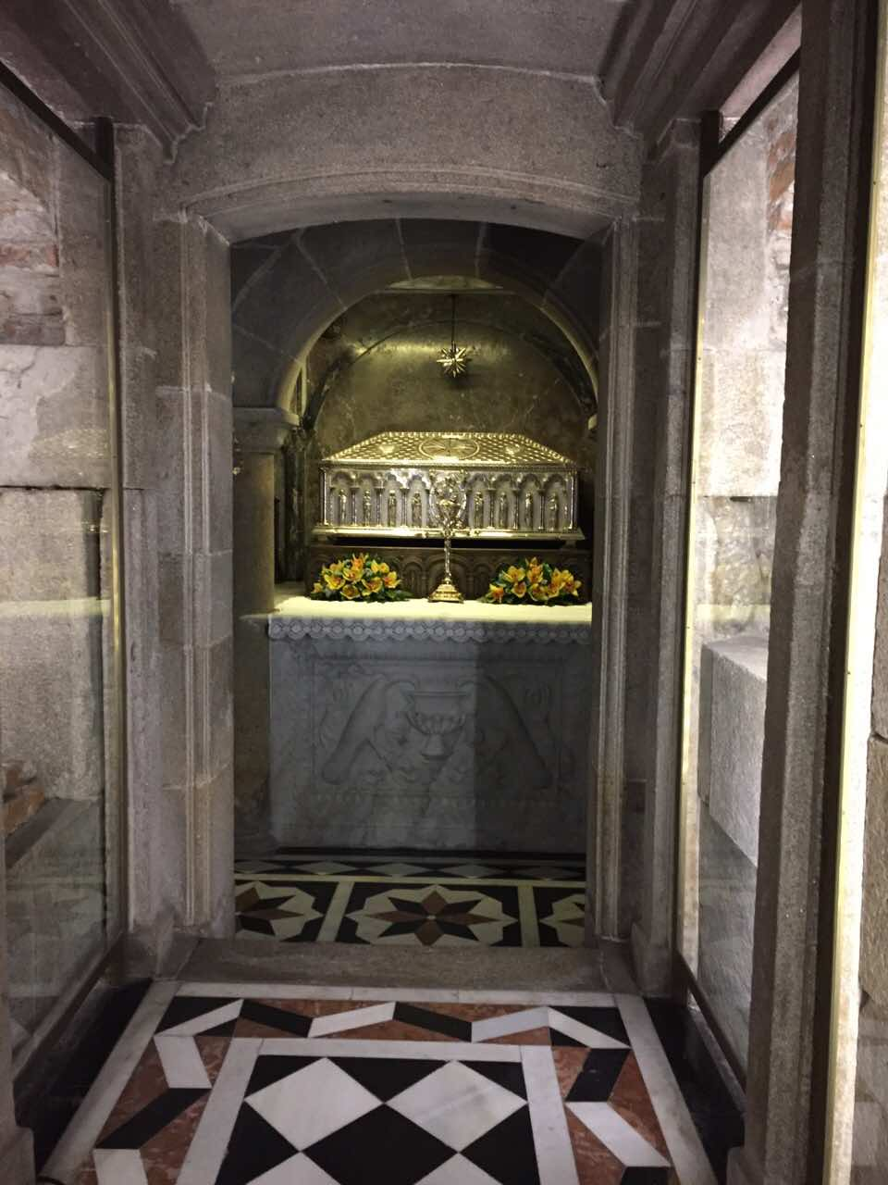
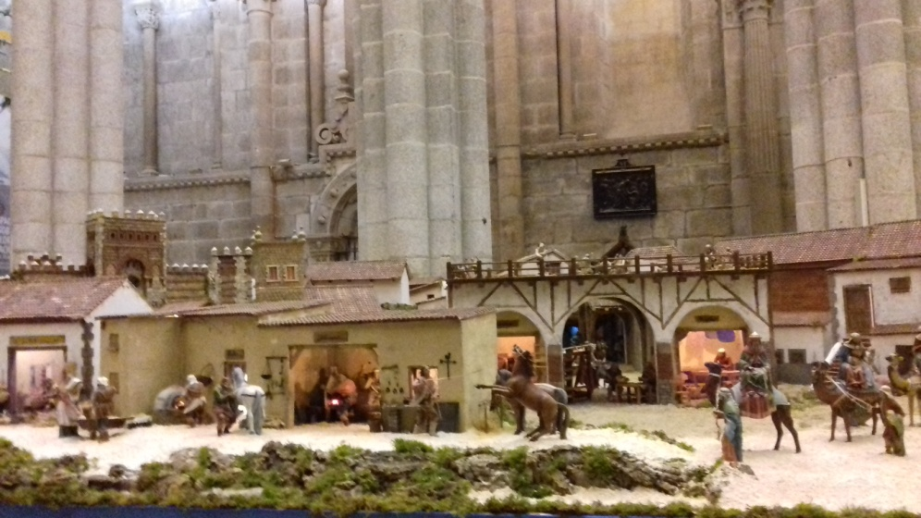

Slide 15
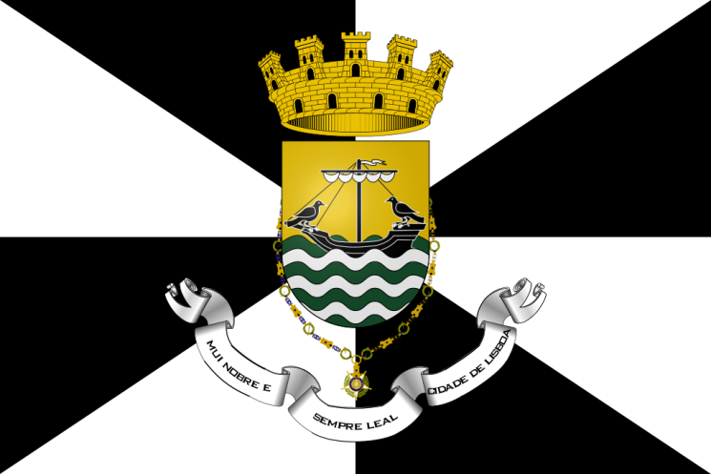
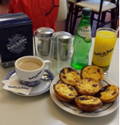
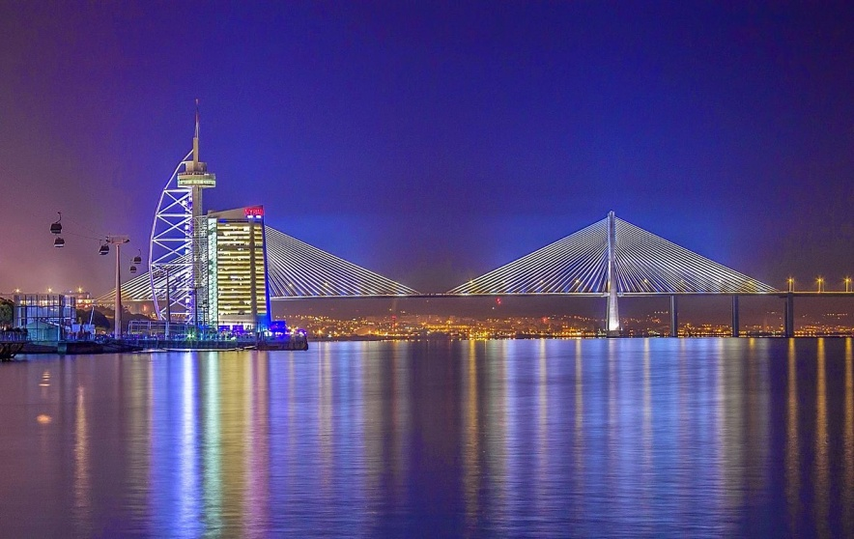
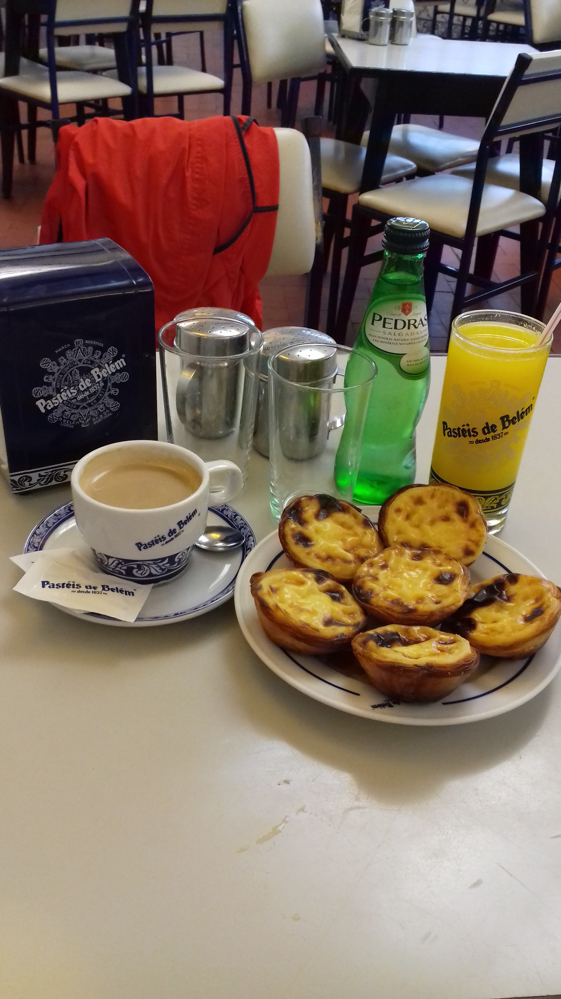
4. LISABON
the capital of Portugal
Area 958 km²
Population 2,685,000

Slide 16
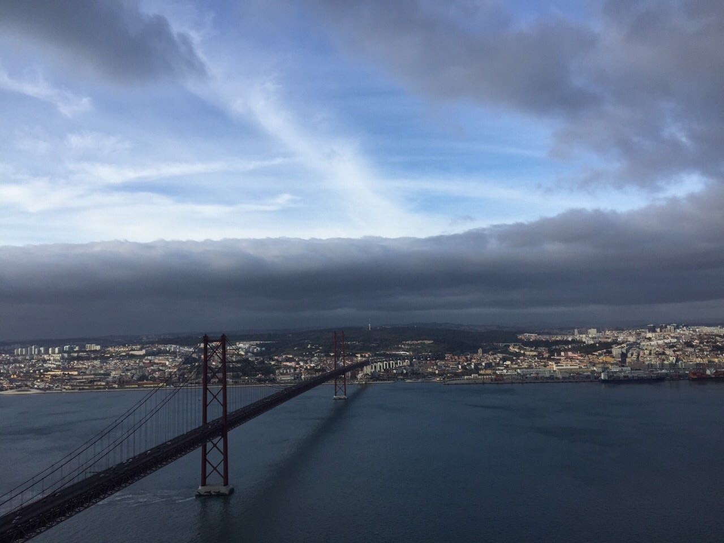
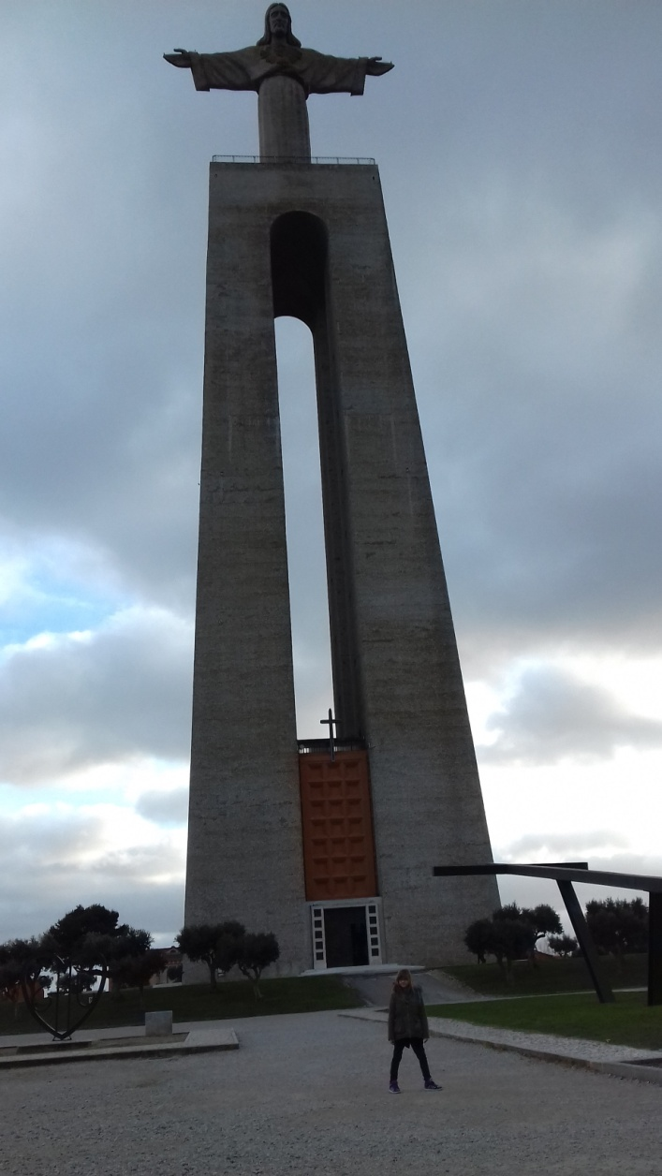
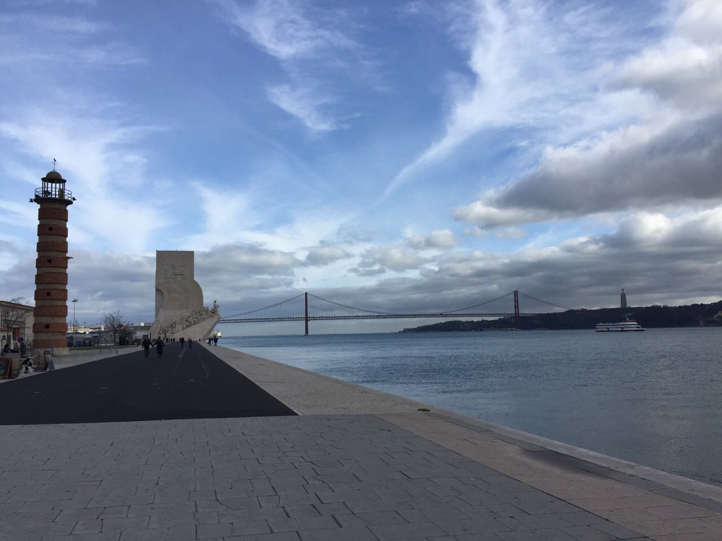

Slide 17
CABO DA ROCA

